Slide 1
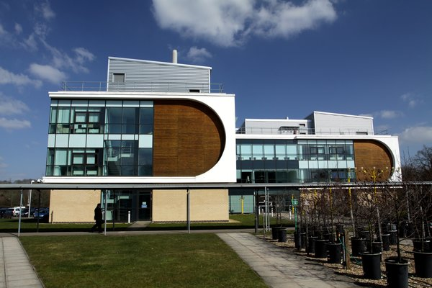
Correspondence/home/in-dependent study
Broadcast radio and television
Open universities
Online Internet-based virtual classes
Interactive teleconferencing
1873 – Anna Eliot Ticknor founded the Society to Encourage Studies at Home.
1881 – Chautauqua Correspondence College was founded.
1926 – The National Home Study Council was founded for school regulation.
1969 – The first open university, called “The Open University” was established in the United Kingdom.
1972 – Three years later, the Universidad Nacional de Educación a Distancia was established in Spain.
1979 – In China, the country with the largest population, the Open University of China was established.
1975 – The Altair 8800, the first PC, became available to consumers.
1989 – 15% of American homes had a PC.
1993 – Mosaic, the first web browser, was released.
1921 – First education radio license is issued to Latter Day Saint’s University in Salt Lake City, Utah.
1925 – The State University of Iowa offered the first for-credit radio classes.
1934 – The State University of Iowa broadcasted first educational presentations.
1965 – The Educational Telephone Network was set up at the University of Wisconsin.
1974 – ATS-6, the first educational satellite, was launched.
1982 – The National University Teleconferencing Network was thought up in Washington, DC.

